Slide 1



St. Peter’s Catholic Academy
Please feel free to investigate the different ways we have been getting Physically Active!

Slide 2
Every year our teachers evaluate our experiences of P.E.
‘Green’ statements show where our School is doing well, ‘Red’ shows where we are trying to get better!
St Peters (09/2013) | 9 | 30 | 10
St Peters (09/2014) | 23 | 23 | 3
St Peters (09/2015) | 33 | 15 | 1
St Peter's (09/2016) | 33 | 15 | 1
St Peter’s (09/2017) | 35 | 13 | 1
St Peter’s (09/2018) | 31 | 17 | 1
St Peter’s (09/2019) | 32 | 17 | 0
St Peter’s (09/2020) | 32 | 16 | 1
St Peter’s (09/2021) | 35 | 12 | 2
St. Peter’s (09/2022) | 35 | 14 | 0
St. Peter’s (09/2023) | 38 | 10 | 1
St. Peter’s (09/2024) | 38 | 11 | 0
St. Peter’s (09/2025) | 41 | 8 | 0
St. Peter’s (09/2026) | 42 | 7 | 0

Slide 3
Our School is in the process of improving the following areas….
Orange 1: Pupils show very high levels of physical fitness and can work for prolonged periods of time.
Orange 2:Pupils think for themselves and take initiative in the organization and completion of tasks; leadership skills are evident and are actively encouraged.
Orange 3: Links exist with other schools, clubs and sports organizations, which contribute to extending the range and quality of opportunities provided for pupils.

Slide 4
Orange 1: Pupils show very high levels of physical fitness and can work for prolonged periods of time.
Action Plan response:
We have made progress in regard to the pupils resilience and ability to keep moving in lesson time. After Covid we have found some of our pupils were a little short of fitness, whilst data shows they have begun to make a recovery. We still feel that all of our children would benefit from being encouraged to challenge themselves to move a little more throughout each day.
Mr. Sigley and Mrs Wilshaw are running a plethora of initiatives to inspire the children to be the best they can be. We will also continue to teach our engaging curriculum, facilitate active play times, use our effort bags as a reward and to tackle socio-economic barriers, as well as our Wall of Fame and Healthy Lifestyle week.

Slide 5
Orange 2:Pupils think for themselves and take initiative in the organization and completion of tasks; leadership skills are evident and are actively encouraged.
Action Plan response
Throughout this year, we have been working hard to encourage children to take ownership of leading and organising games both in lessons and during playtimes. This is an area we are keen to continue developing further in the next academic year.
CSI will deliver playground leader sessions to model and support children in leading activities during break and lunch times. We are also restructuring playtimes to make them more active, promoting fitness, teamwork and leadership skills across the school.

Slide 6
Orange 3: Links exist with other schools, clubs and sports organizations, which contribute to extending the range and quality of opportunities provided for pupils.
Action Plan response:
We think our children are amazing at St. Peter’s – especially in P.E! We think it’s time our local community knows it too.
Throughout 2026/27, we aim to inspire our children to be as active as possible outside of school. We will continue to strengthen our links with community sport and physical activity providers, while monitoring how many of our children are taking part. This year, we will also maintain our external partnerships to offer a range of sports opportunities both during curriculum time and through after‑school clubs.
Ultimately we want our children to lead a healthy, happy and safe life. The best way to do that is to join in organised exercise outside of School.

Slide 7
Current ‘regular, organised’ extra-curricular participation
September 2026 |  | December 2026
Y1 |  | Y1
Y2 |  | Y2
Y3 |  | Y3
Y4 |  | Y4
Y5 |  | Y5
Y6 |  | Y6
% of School |  | Hopefully we increase!

Slide 8
St.Peter’s Active Superheroes!
We will celebrate our pupils fantastic progress and achievements in and out of School on the Wall of Fame!
Look out for our effort bags! (We reward you’re hard work and progress by helping you stay active outside of School!)

Slide 9

Swimming data
 | Beginners (Award 1) | Length (Award 2 – swim 25 meters competently)
Year 6 | 100% | 49%

Slide 10


Slide 11
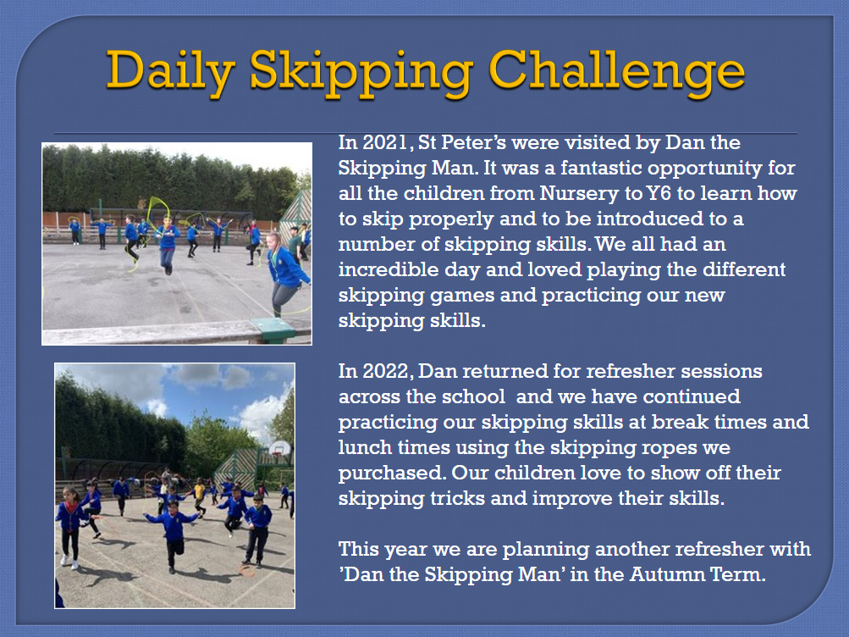

Slide 12
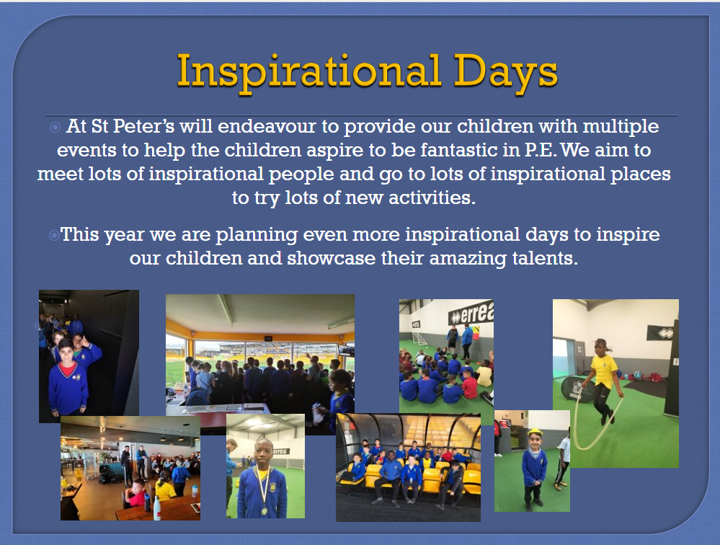

Slide 13
We will be meeting parents!
Mr. Sigley likes to meet with the parents to discuss all things P.E at St. Peter’s and issues in the local area surrounding activity levels and sedentary lifestyles.
It involves the children joining in and we all play fun games that involve little equipment and are easy/fun to play!
In 2024/25 we can start to run these again – and we can’t wait!
Our first one of the year is Friday 6th September – first thing in the morning!

Slide 14

Active Families workshop 2026/27
Monday 21st September

Slide 15
Meet our Playground leaders for 2026/27!

Slide 16
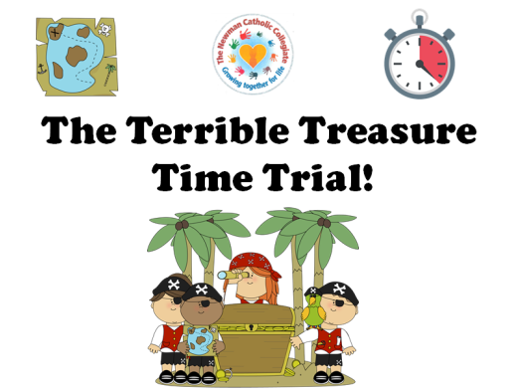
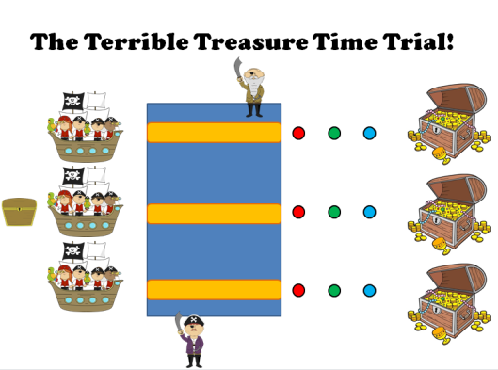
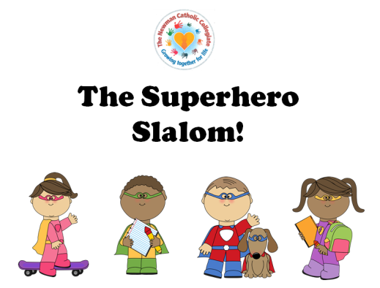
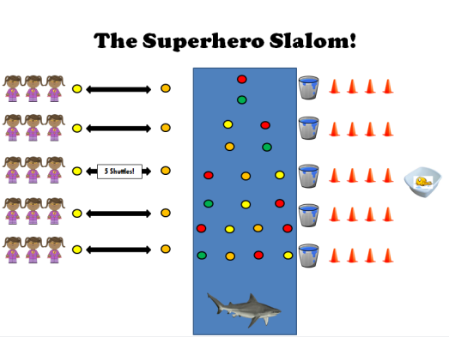
Fitness Focused
Inter-House!
At St. Peter’s this year our children will be focusing on getting as fit as possible and staying healthy!
Children at St. Peter’s will compete in our brand new, fitness focused, Inter-House competitions once every term. They will find out what the competition entails at the start of each term and the competition will take place at the end of the term.
Playground leaders will set up and lead the activities involved at dinner times, allowing the children to train for the upcoming event. First up in Autumn is ‘The Terrible Treasure Time Trial’ and in Spring the children will negotiate the ‘Superhero Slalom’!
This new addition to the already vibrant P.E offer will hopefully inspire the children to getting even fitter (and it will be also be great fun!)

Slide 17
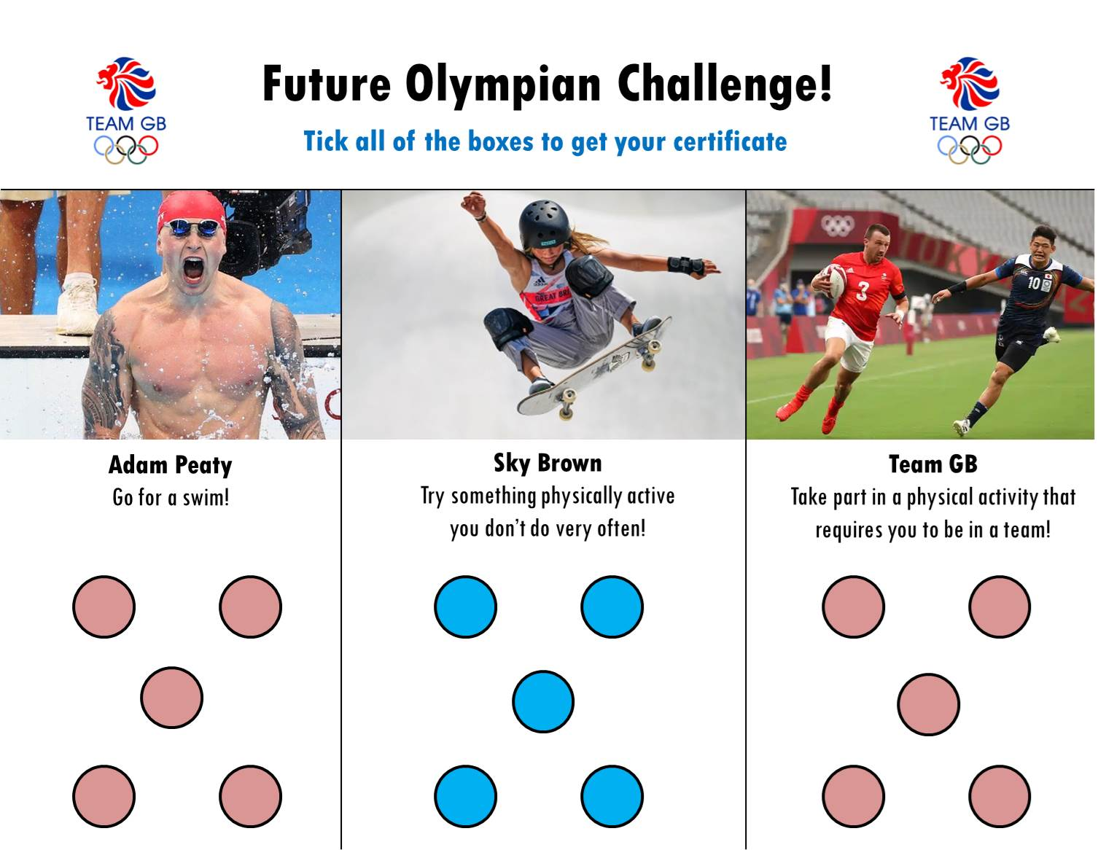
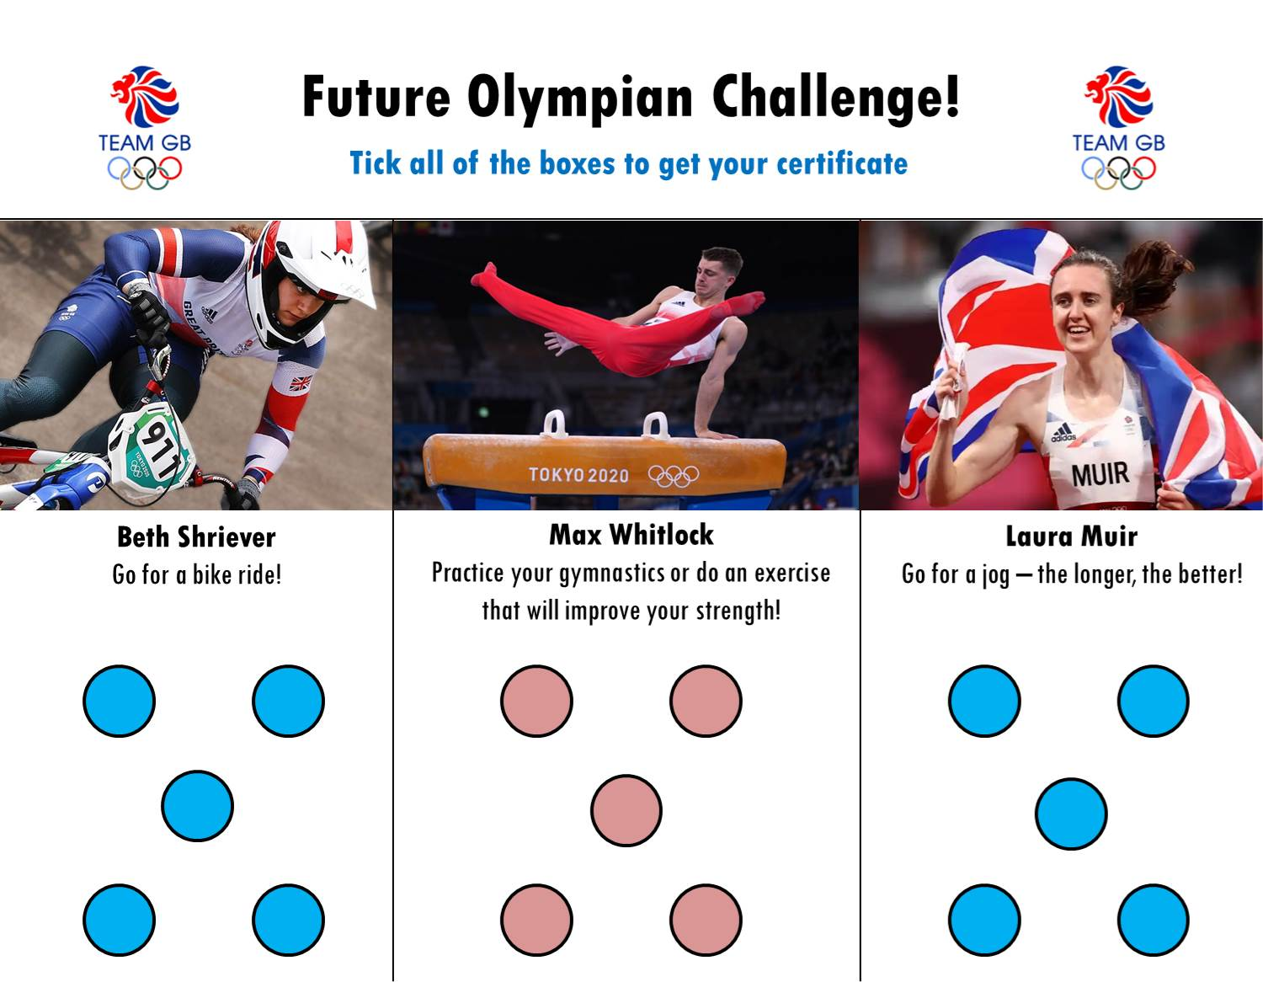
Our Olympic Challenges!

Slide 18


