Slide 2


2
two

Slide 3





5
five

Slide 4









9
nine

Slide 5



3
three

Slide 6




4
four

Slide 7






6
six

Slide 8

1
one

Slide 9







7
seven

Slide 10


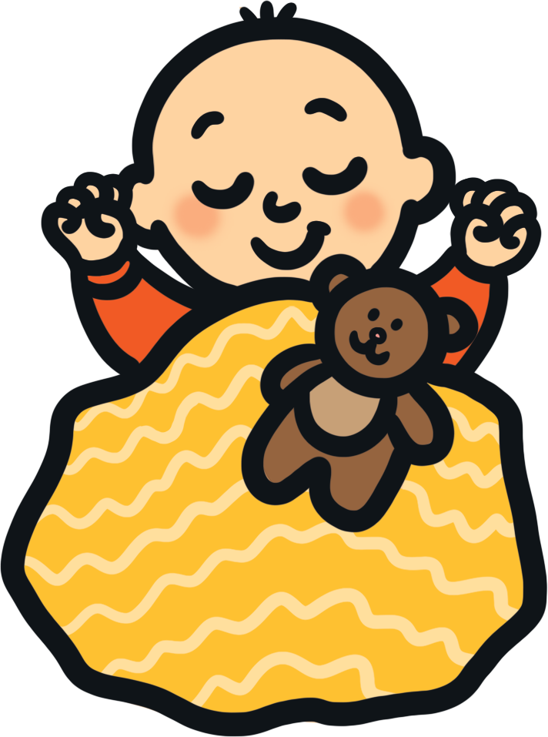

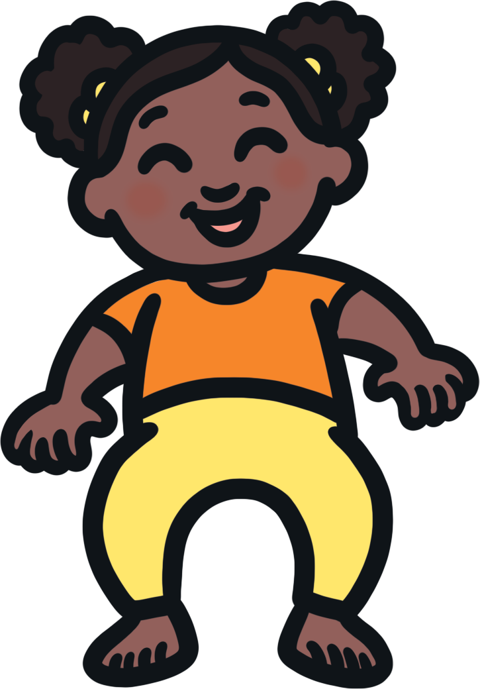
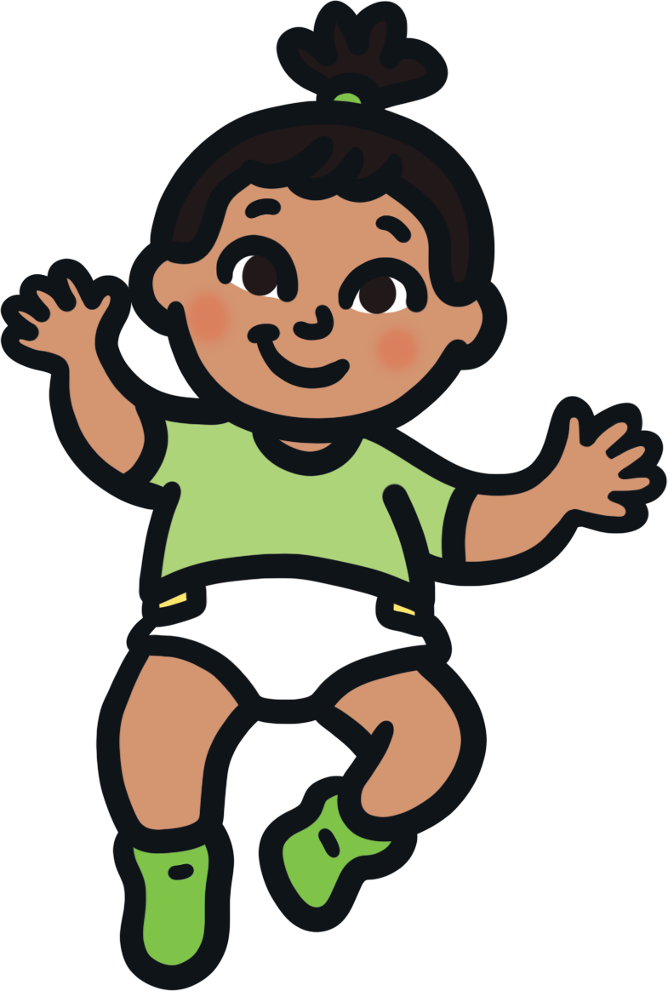

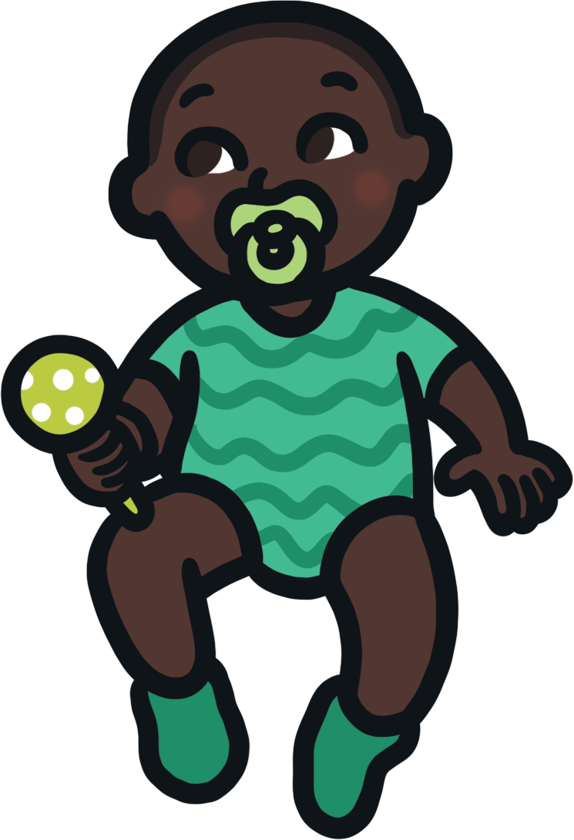

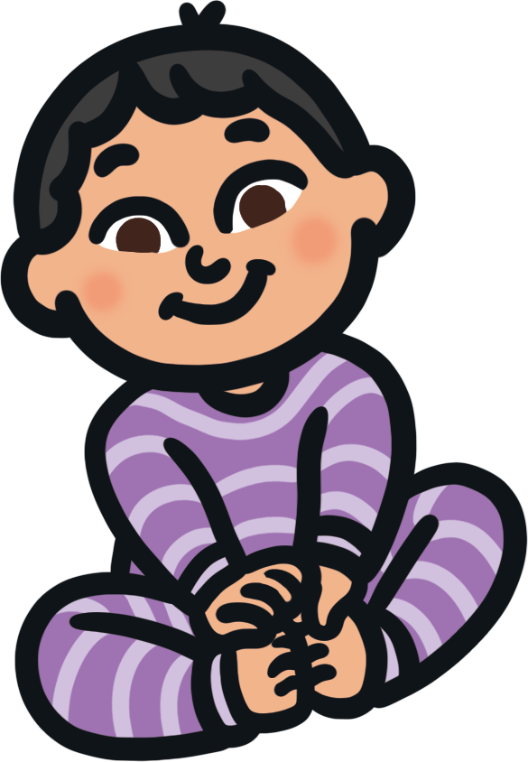
10
ten

Slide 11








8
eight

Slide 12
Let’s count to 10!
1
2
3
4
5
one
two
three
four
five
6
7
8
9
10
six
seven
eight
nine
ten

Slide 13

Can you find the matching number?
1
2
3

Slide 14


Can you find the matching number?
4
5
6

Slide 15

Can you find the matching number?
8
9
10

Slide 16
Can you find the matching number?
1
one
2
3

Slide 17
Can you find the matching number?
3
four
4
5

Slide 18
Can you find the matching number?
7
seven
8
9

Slide 19
Can you find the matching number?
9
eight
nine
ten

Slide 20
Can you find the matching number?
2
two
three
four

Slide 21
Can you find the matching number?
10
eight
nine
ten

Slide 22
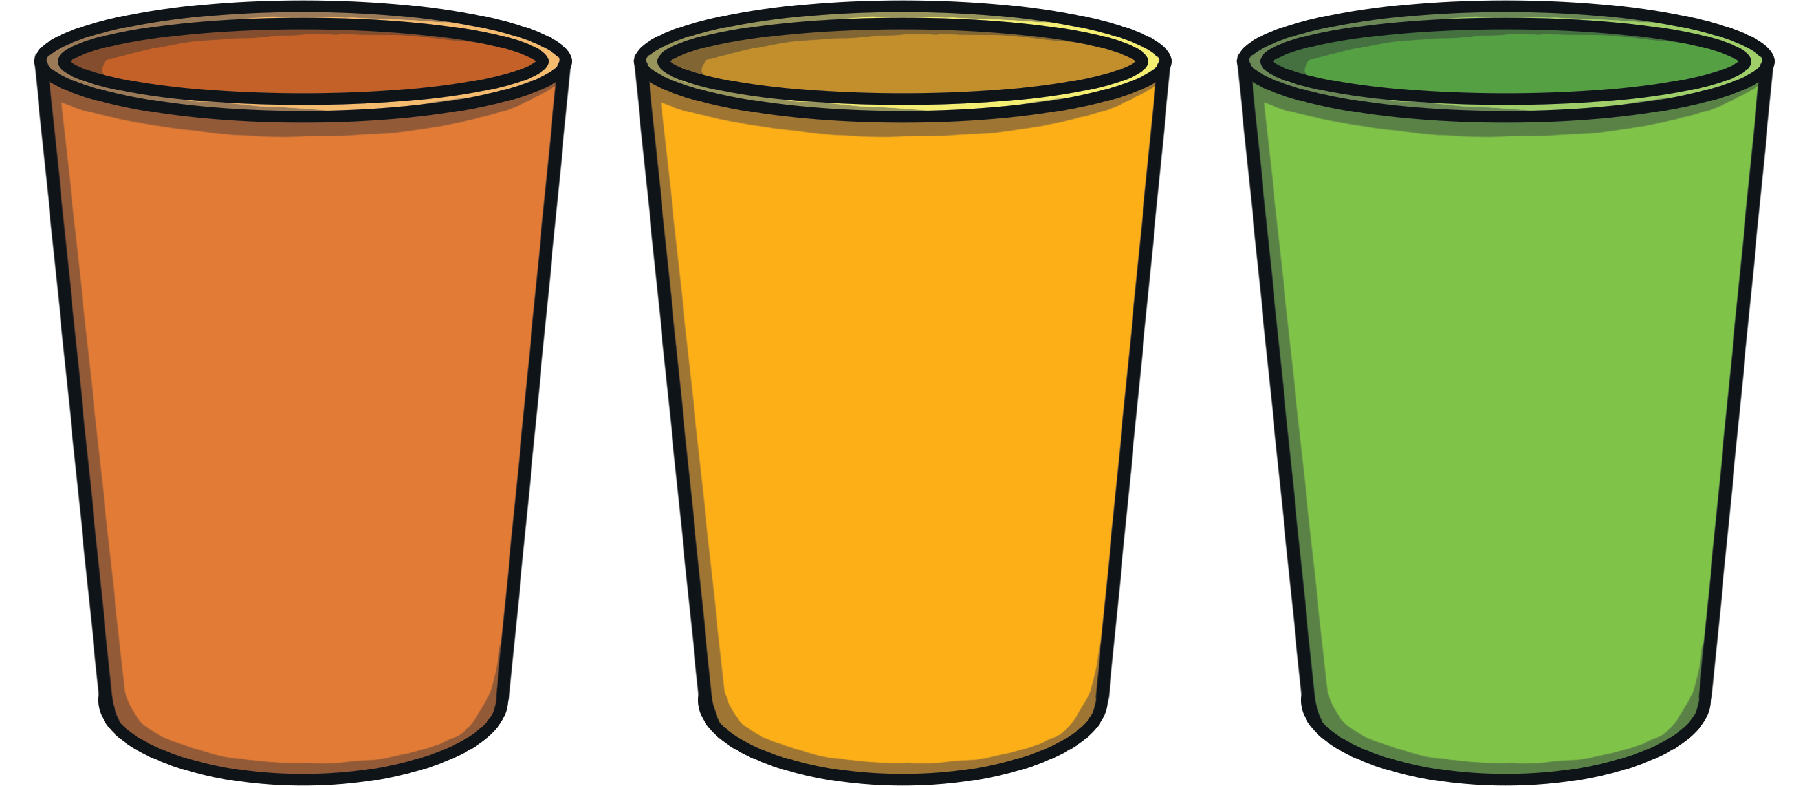
Can you find the matching number?

Slide 23

Can you find the matching number?

Slide 24
Can you find the matching number?

Slide 25
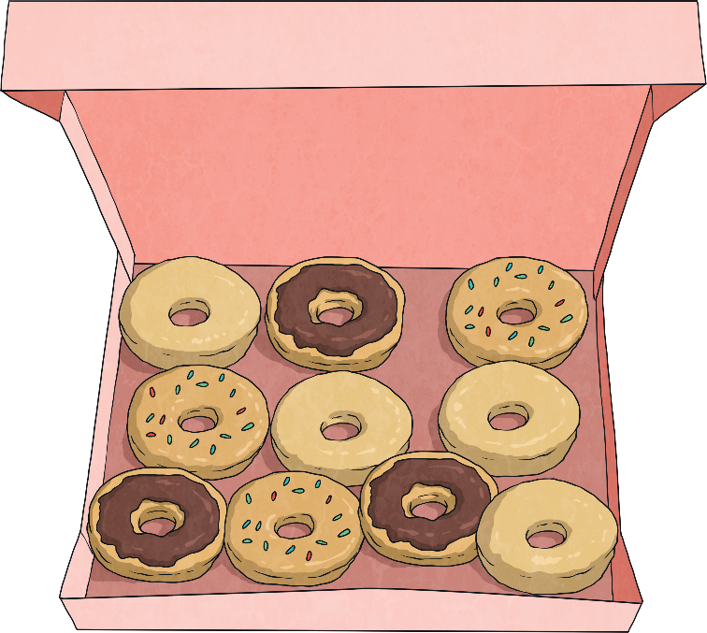

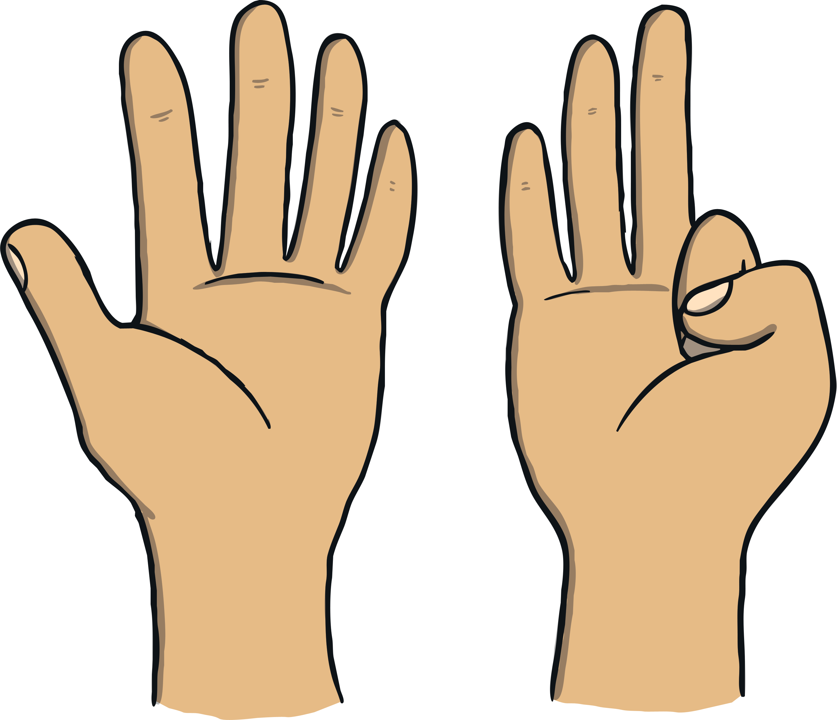
Well done!
What else can you find to count today?

