Slide 1
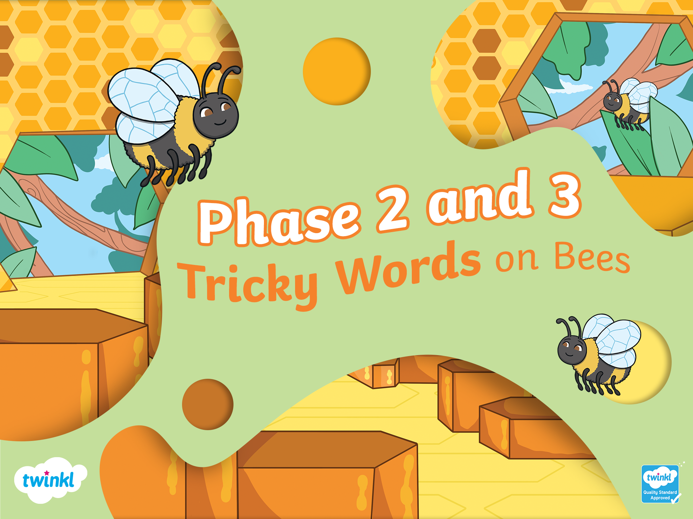

Slide 2



he
they
are
to
I
the
no
into
go
Click here

Slide 3
all
her
you
my
me
be
was
we
she
Click here

Slide 4
