Slide 2
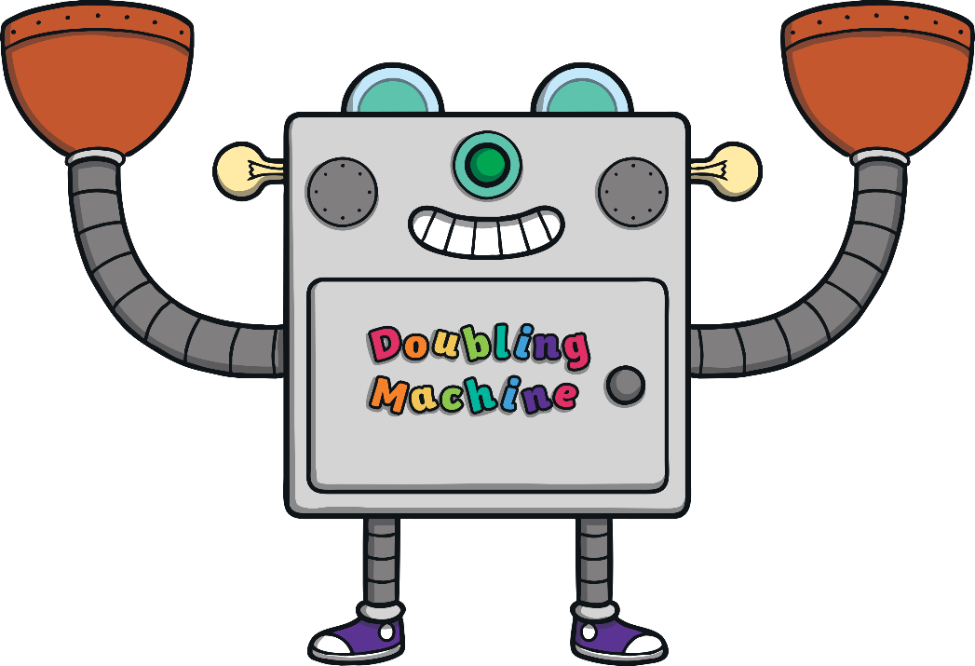
Instructions
Beep! Beep!
Hello everyone! I am the doubling machine.
I love doubling things!
Can you give me some bricks to double?
Can you work out the answer?
Beep! Beep!

Slide 3
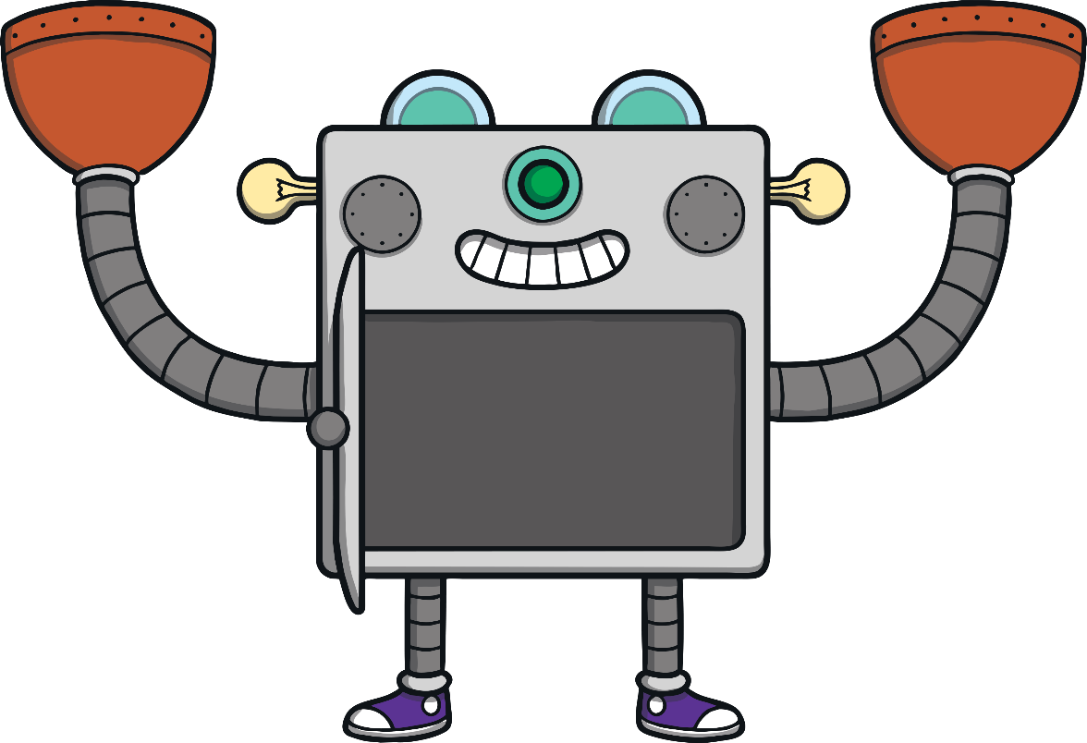
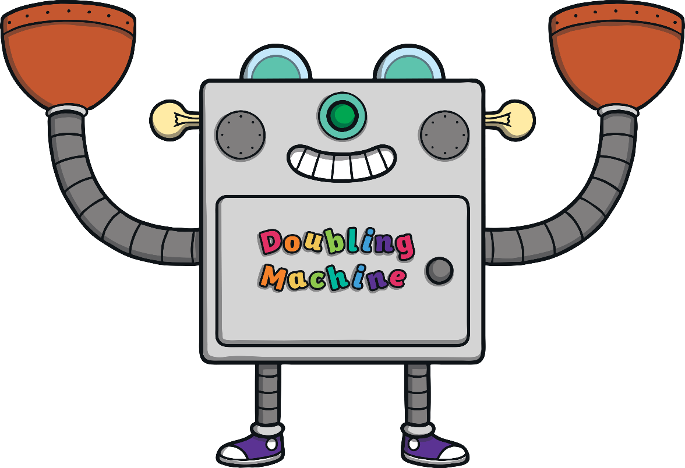

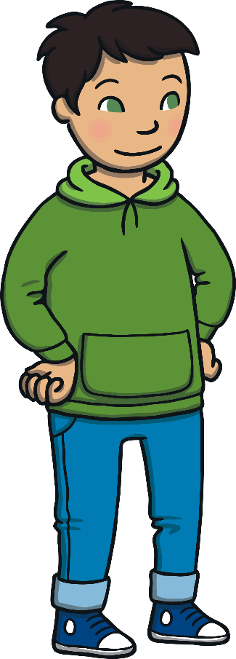
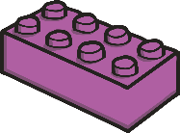

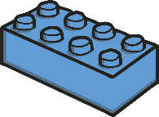



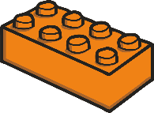




Click on the bricks to help Neeta and Karl place them into the doubling machine.
Then, click the door to open the doubling machine and look inside!
double 1 is 2

Slide 4


Click on the bricks to help Kajeen and Rita place them into the doubling machine.
How many bricks are in the doubling machine? What is double 2?
double 2 is 4

Slide 5
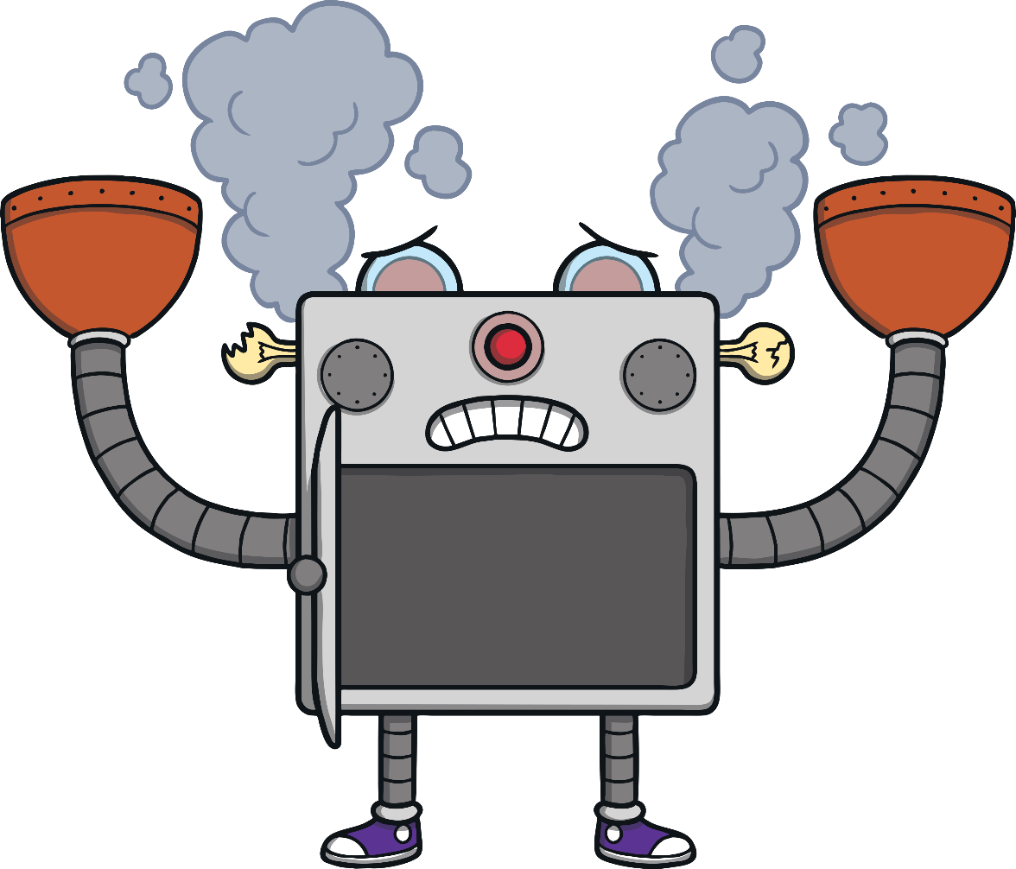


Click on the bricks to help Paul and Nadia place them into the doubling machine.
Can you open the door and look inside? What happened? Why?
3 and 2 is not a double

Slide 6






Click on the bricks to help Paul and Nadia to try again.
What is double 3? Can you check by counting the bricks inside the
doubling machine?
double 3 is 6

Slide 7


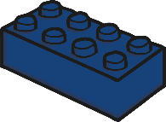
Click on the bricks to help Anna and Felix place them into the doubling machine. Can you tell a friend what happened?
How many bricks should Felix place into the machine to make a double?
4 and 3 is not a double

Slide 8








Click on the bricks to help Anna and Felix try again.
Can you show a friend double 4 using your fingers? What is the answer?
double 4 is 8

Slide 9












Click on the bricks to help Nadifa and Noah place them into the
doubling machine.
What is double 5? If you and a friend both hold up 5 fingers, how many are there altogether?
double 5 is 10

Slide 10
Thank you for helping me work out
all these doubles.
Look at all the doubles we found – can you spot any patterns?
double 1 is 2
double 2 is 4
double 3 is 6
double 4 is 8
double 5 is 10

