Slide 2
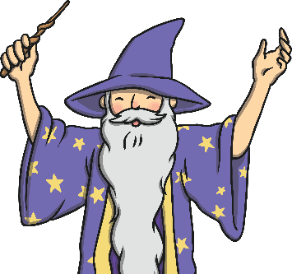
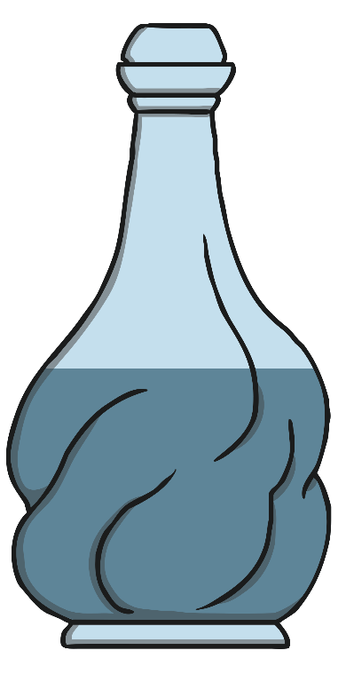
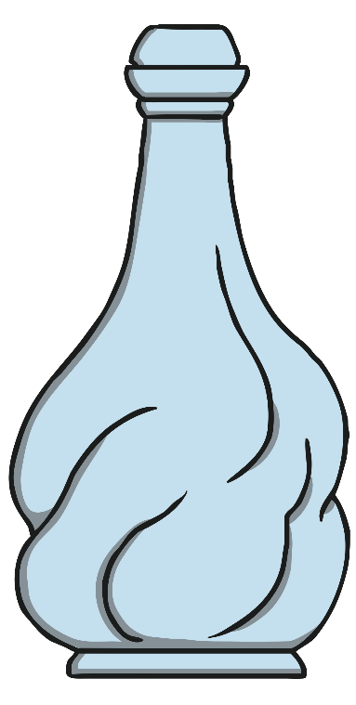
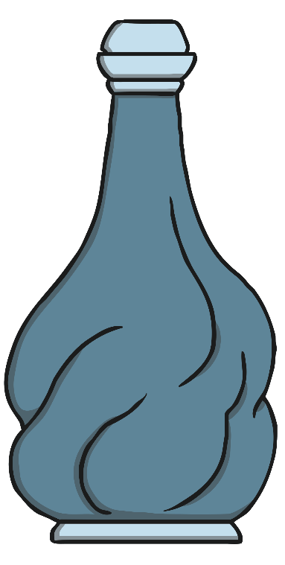
Pick the Potion
Will the Wizard needs help finding the right potions.
Click on the potion that is full.
back
next

Slide 3
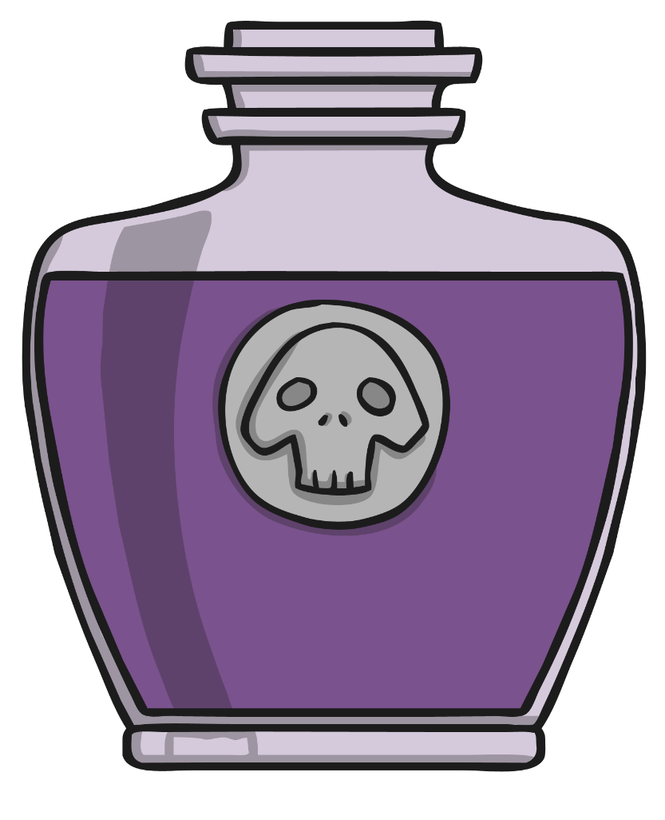
Try again!
back

Slide 4

Correct!
next

Slide 5
Pick the Potion
Will the Wizard needs help finding the right potions.
Click on the potion that is empty.
back
next

Slide 6
Try again!
back

Slide 7
Correct!
next

Slide 8
Pick the Potion
Will the Wizard needs help finding the right potions.
Click on the potion that is half full.
back
next

Slide 9
Try again!
back

Slide 10
Correct!
next

Slide 11
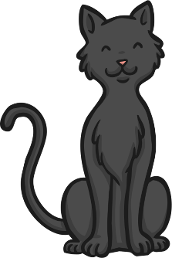

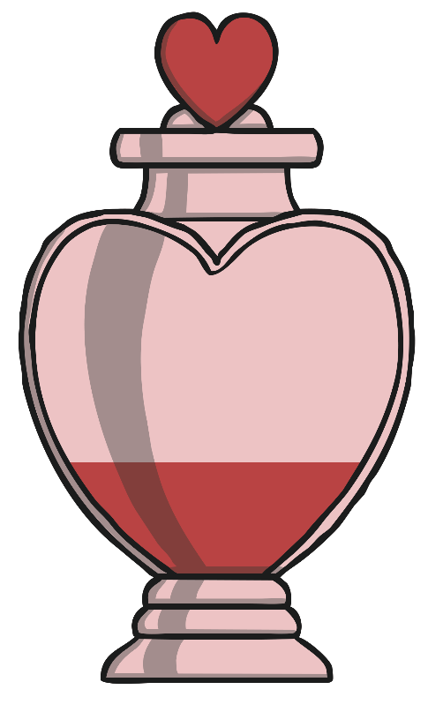

Order the Potions
Hocus the Cat needs help to put the potions in order for Will the Wizard. Click on the bottle that has the least.
back
next

Slide 12
Try again!
back

Slide 13
Correct!
next

Slide 14
Order the Potions
Hocus the Cat needs help to put the potions in order for the Will the Wizard. Click on the bottle that has the most.
back
next

Slide 15
Try again!
back

Slide 16
Correct!
next

Slide 17
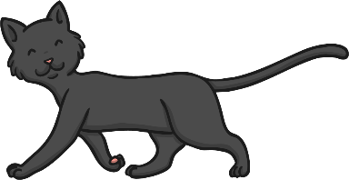

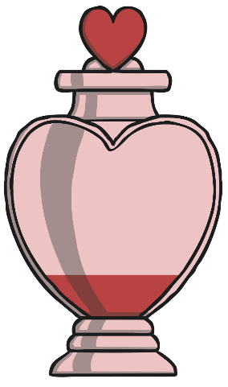
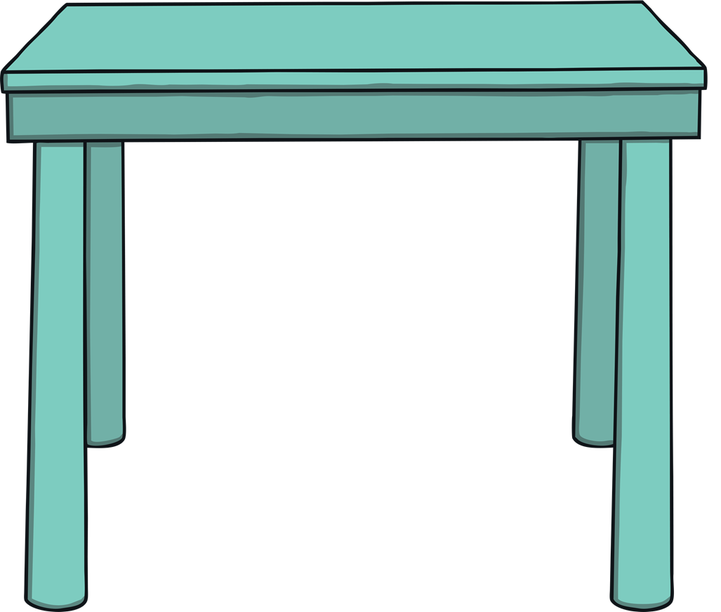
Order the Potions
Now her brother, Pocus the Cat, needs your help. Talk about where these two potions would go on the table from the least to the most. Click on each potion to check.
least
most
back
next

Slide 18

Order the Potions
Pocus the Cat needs your help again. Talk about where these three potions would go on the table from the least to the most. Click on each potion to check.
least
most
back
next

Slide 19
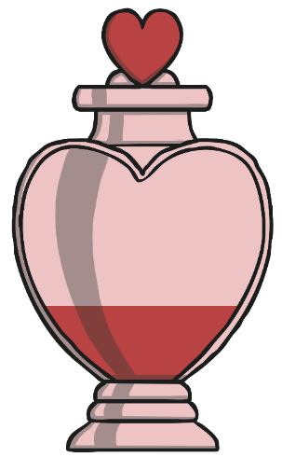
Order the Potions
Pocus the Cat needs your help for the last time. Talk about where these four potions would go on the table from the least to the most. Click on each potion to check.
least
most
back
next

Slide 20
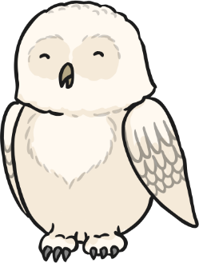
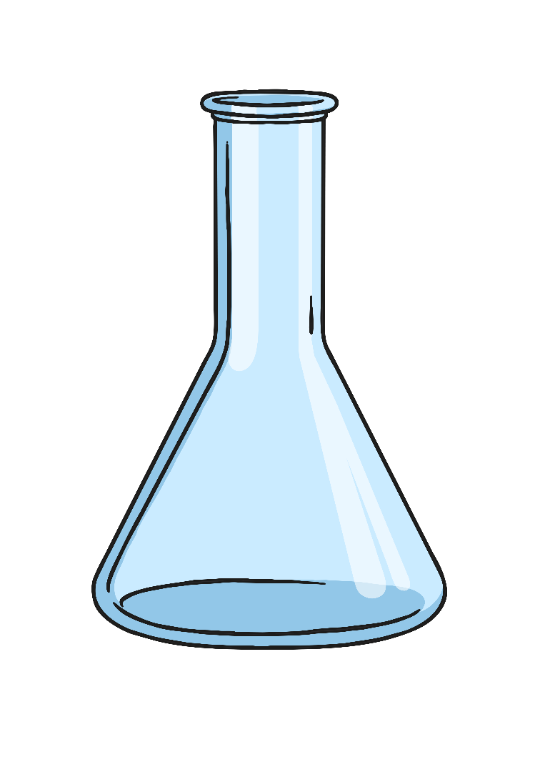
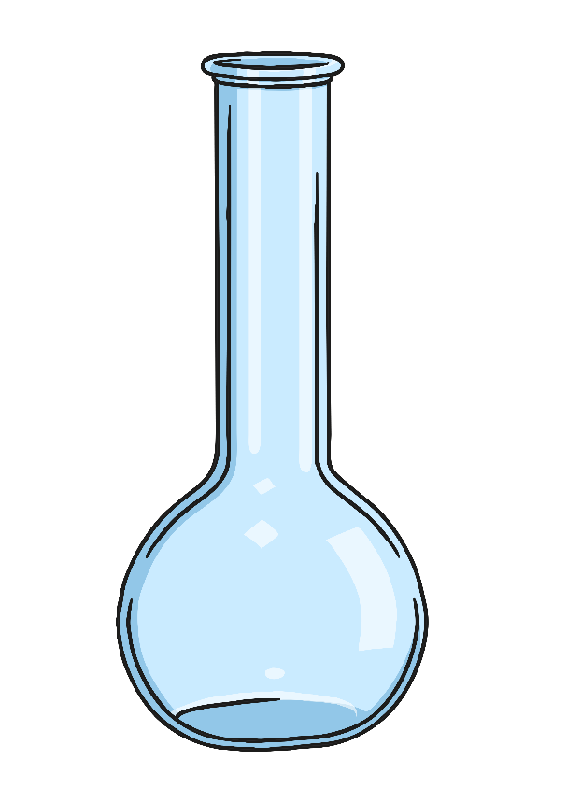
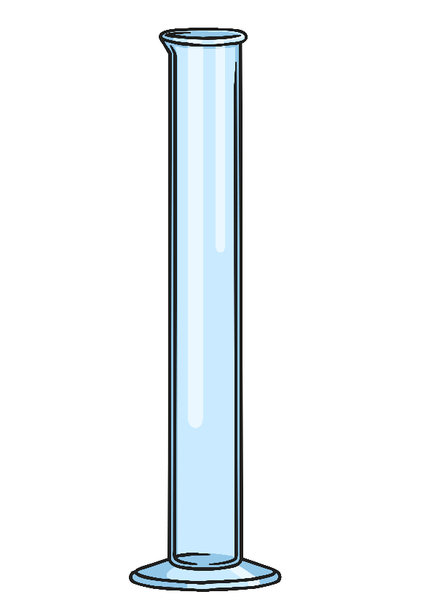
Choose the Container
Otti the Owl needs to choose the container that will hold the most liquid for her perfect potion. Click on the container that will hold the most.
back
next

Slide 21
Try again!
back

Slide 22
Correct!
next

Slide 23
Choose the Container
Otti the Owl needs to make sure she recycles the container that will hold the least liquid. Click on the container that will hold the least.
back
next

Slide 24
Try again!
back

Slide 25
Correct!
next

Slide 26
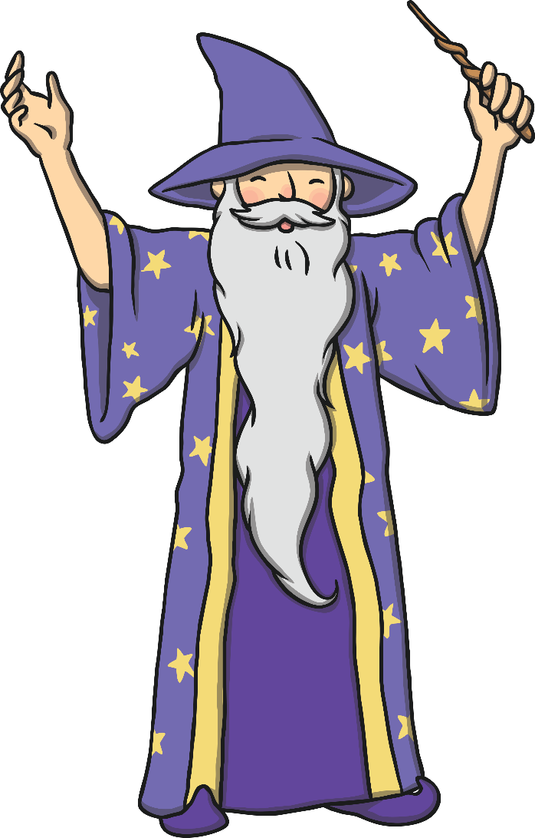
Wizard Challenge!
Will the Wizard has one final challenge...
He tried filling his potion bottle by pouring in four test tubes, but this wasn’t enough to fill it.
The next day, he started again and tried pouring in six, but it overflowed!
How many test tubes should he use to fill up his potion bottle?
Check the answer
back

Slide 27
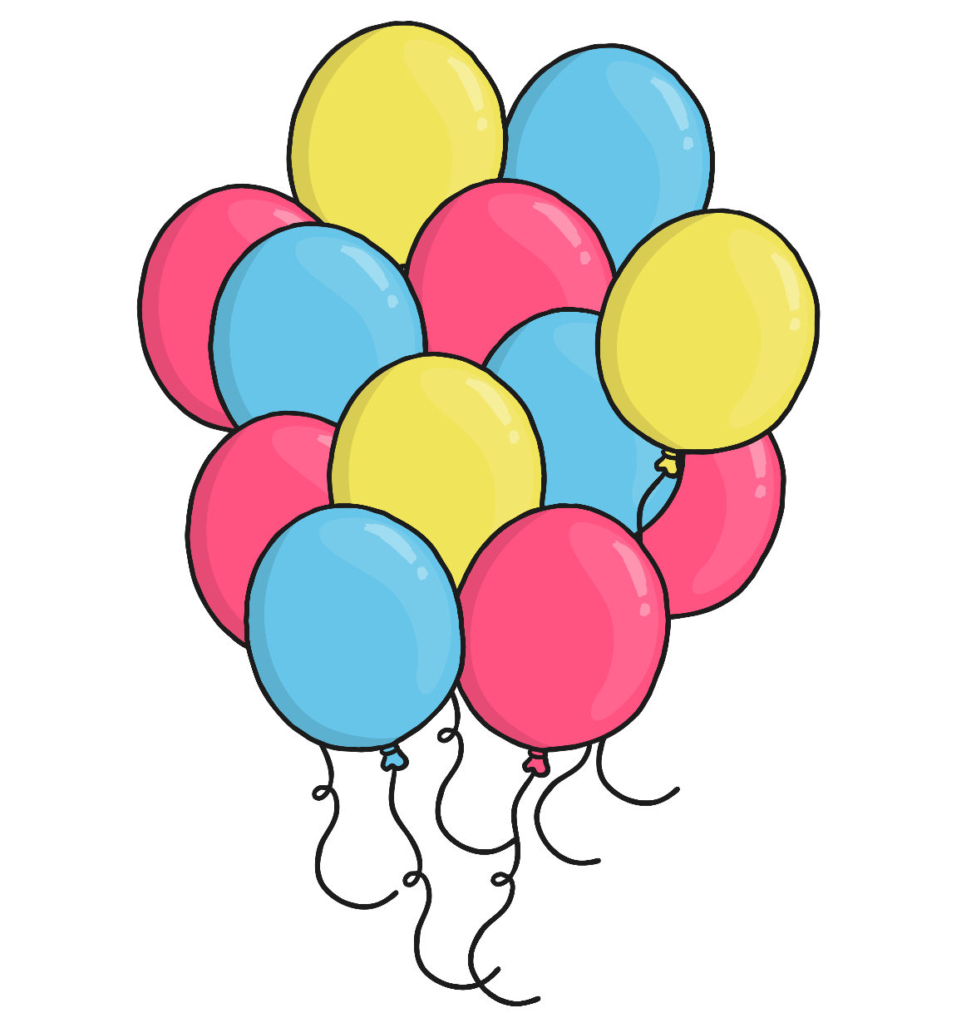

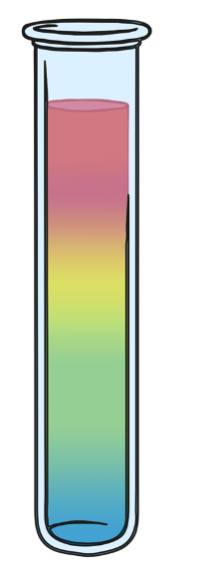

Wizard Challenge Answer!
5
back
finish

